Slide 1
Lists: indexing and slicing.
Week 5 | Lecture 1 (5.1.1)
While waiting for class to start:
Download and open the Jupyter Notebook (.ipynb) for Lecture 5.1.1
You may also use this lecture’s JupyterHub link instead (although opening it locally is encouraged).
Upcoming:
Reflection 5 released Friday @ 11 AM
Lab 5 released today @ 1 AM
Lab 4 due this Friday @ 12 PM
PRA (Lab) on Friday @ 2PM this week

Slide 2
What You Will Learn Today
Lecture 5.1.1
Lists: indexing and slicing
Lecture 5.1.2
Lists: nested lists and looping

Slide 3

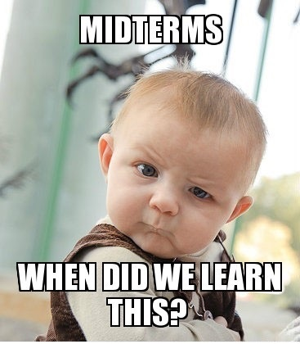
But First! The Midterm…

Slide 4
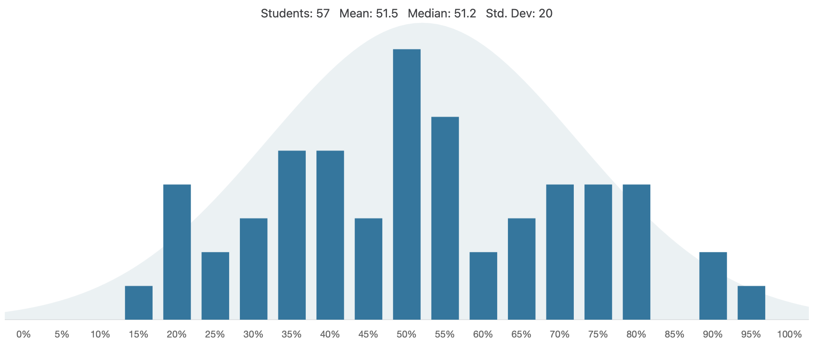
Midterm

Slide 5
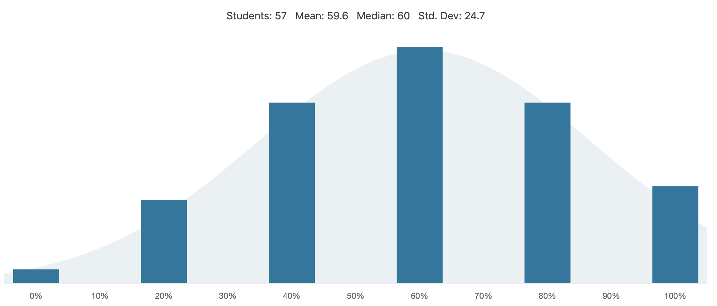
Question 1

Slide 6

Question 1

Slide 7
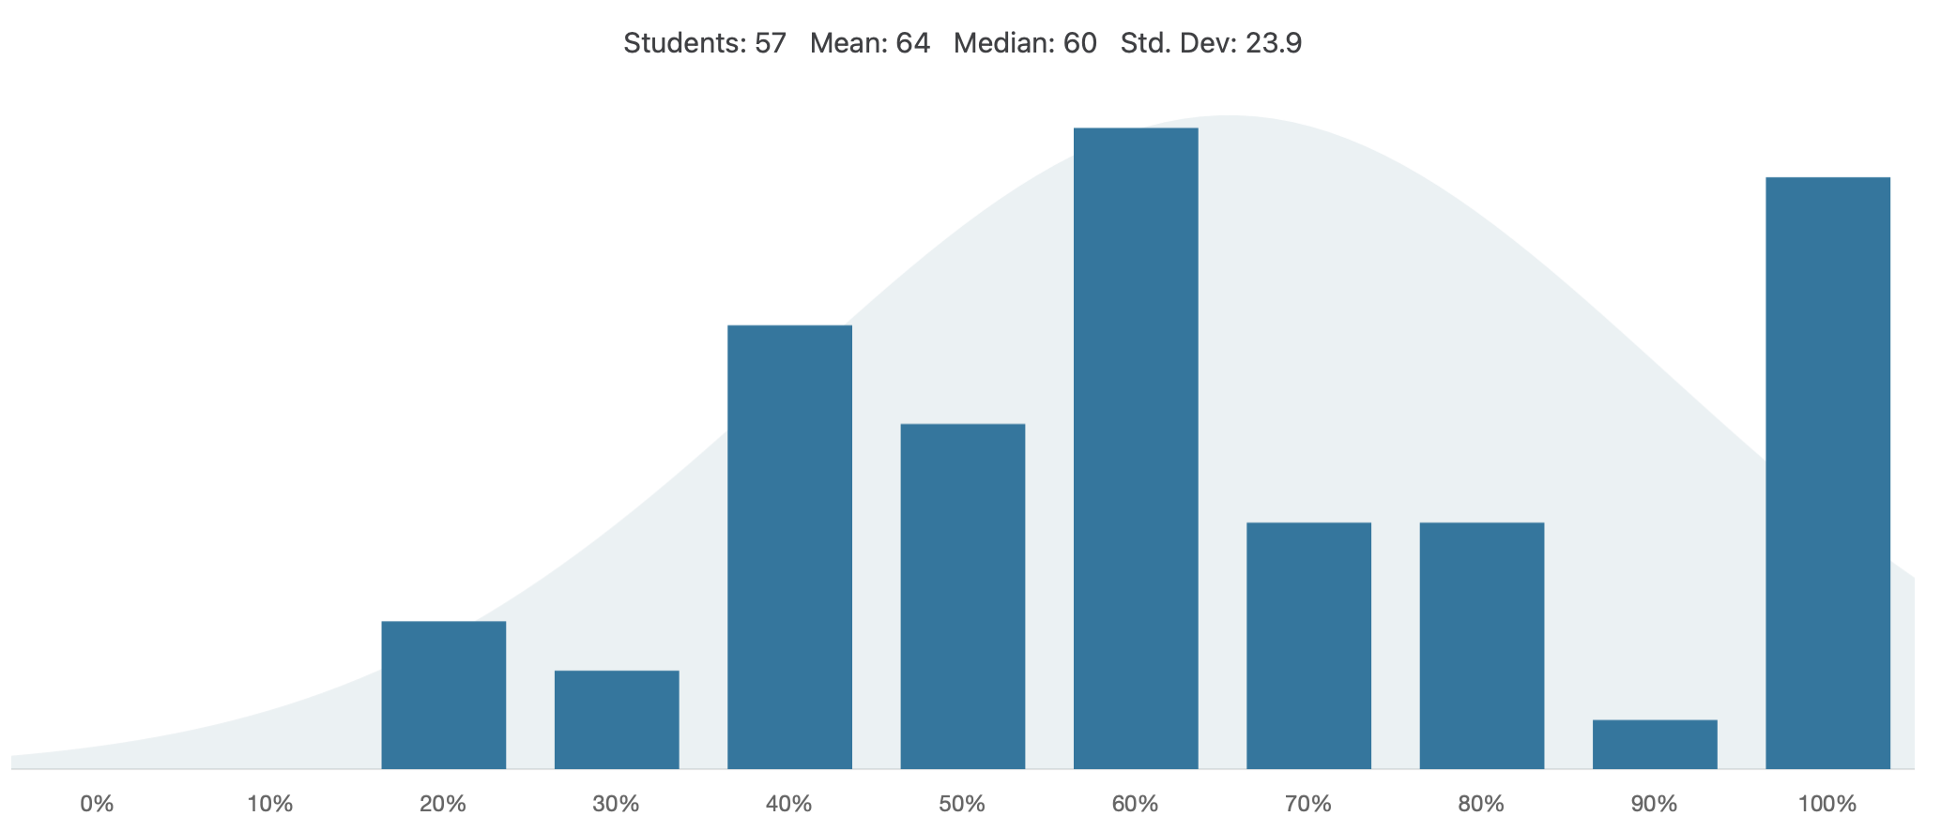
Question 2

Slide 8
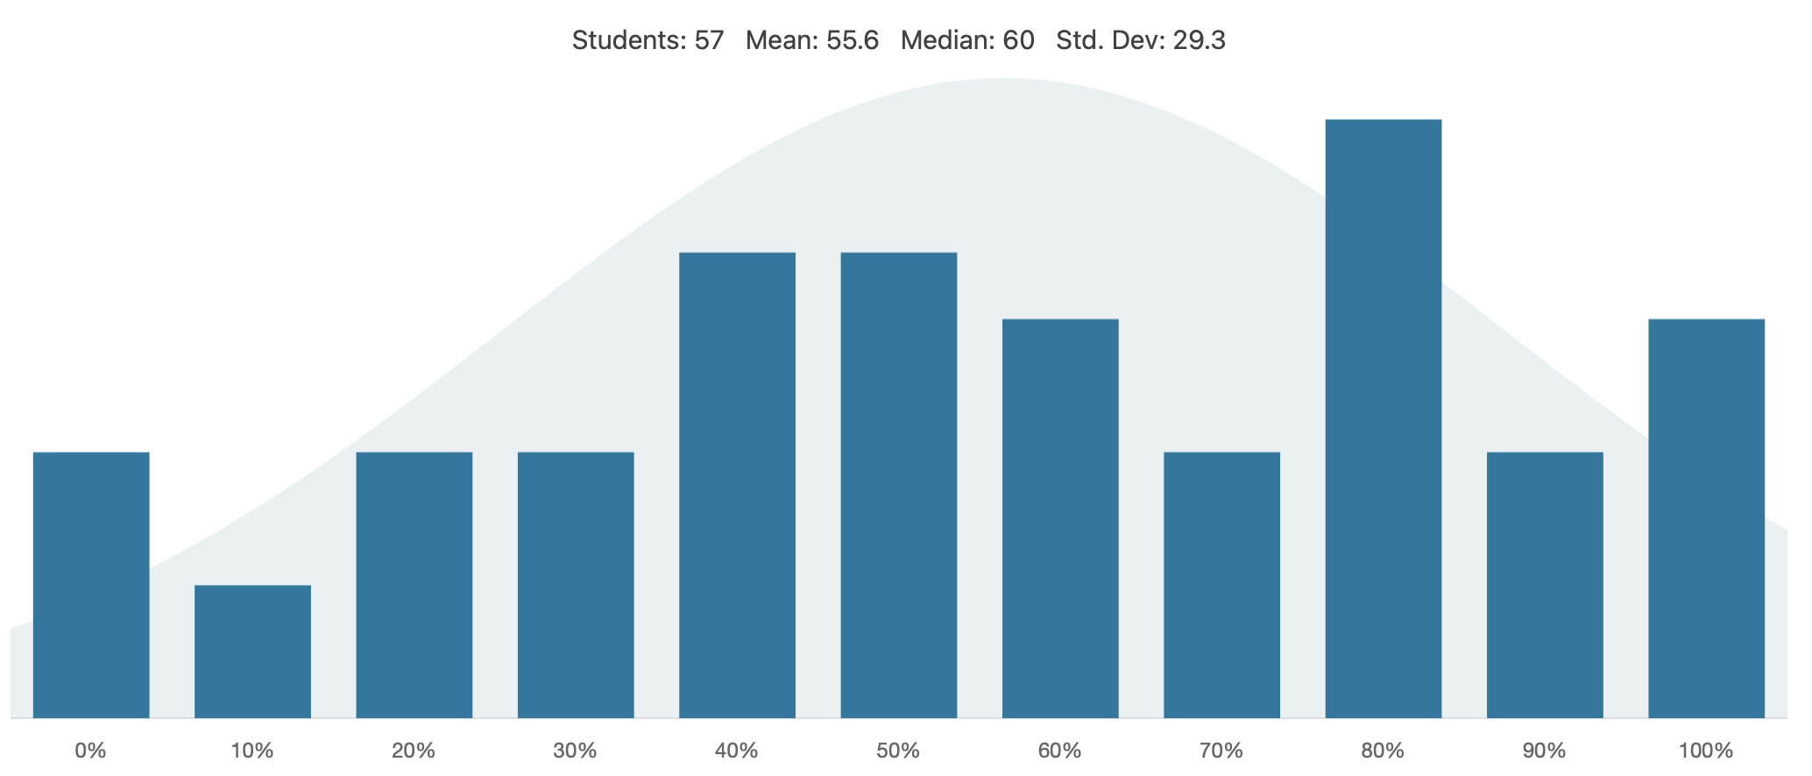
Question 3a

Slide 9
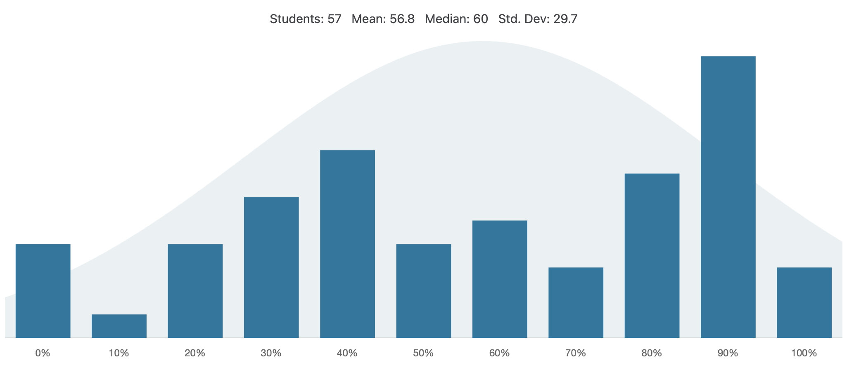
Question 3a

Slide 10
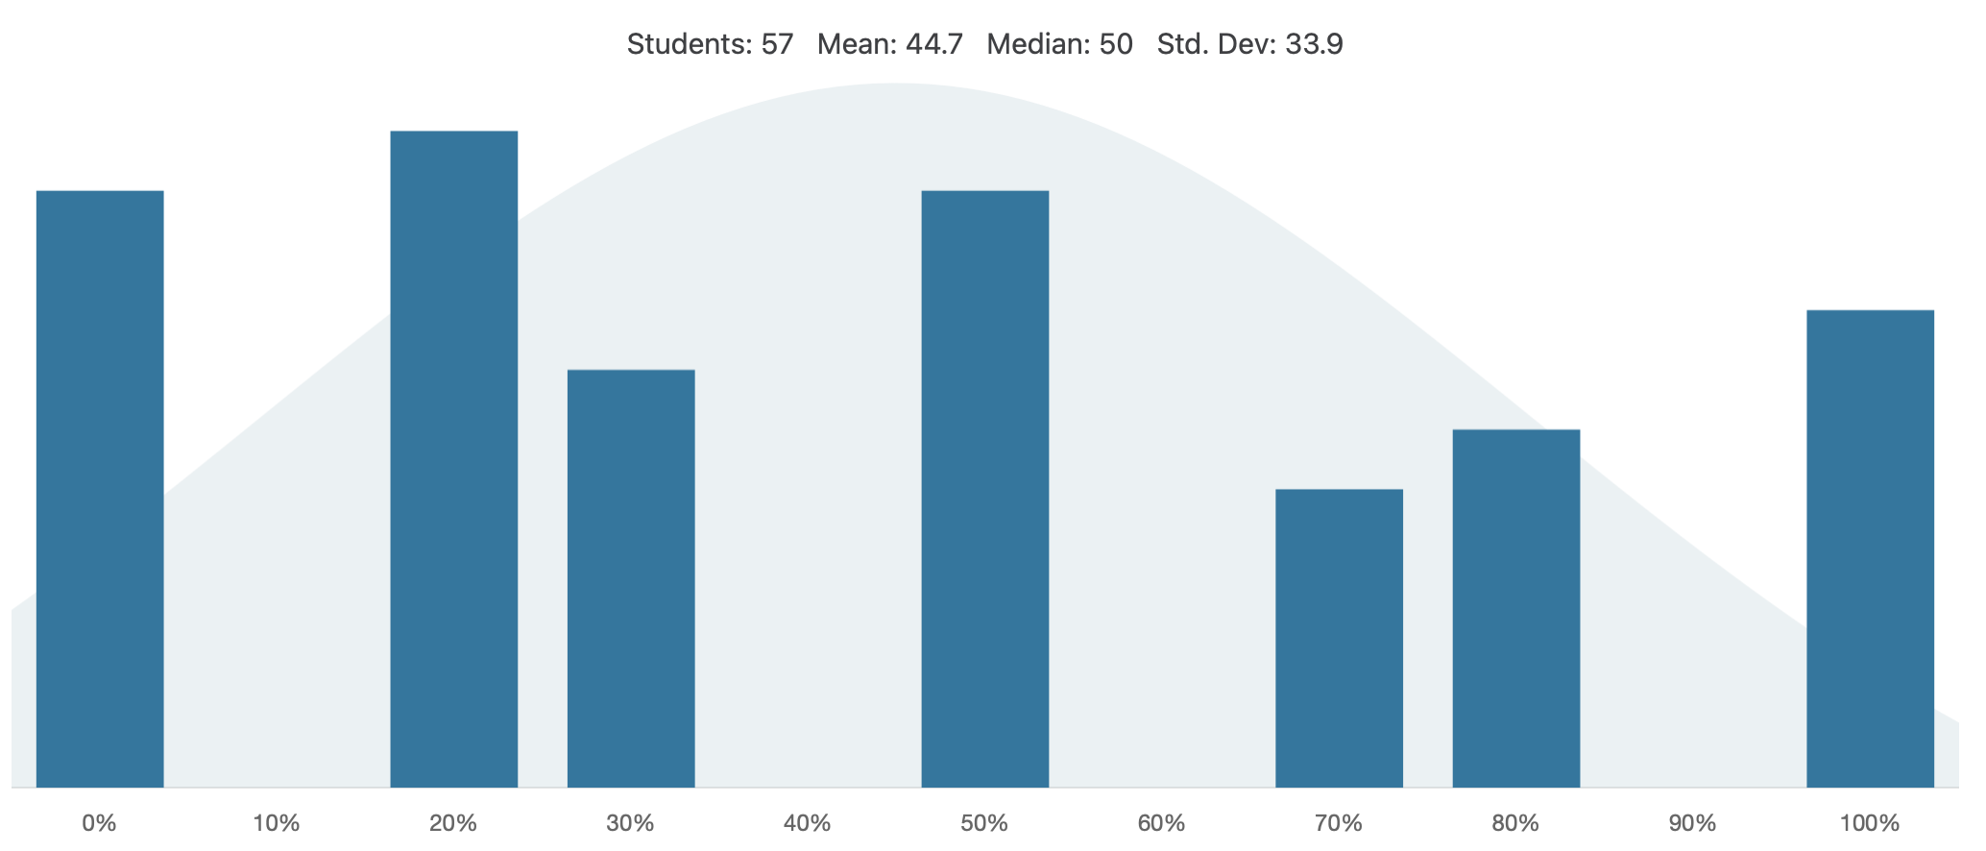
Question 4a

Slide 11
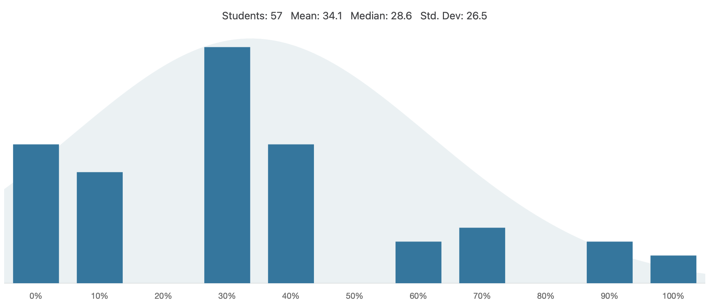
Question 4b

Slide 12
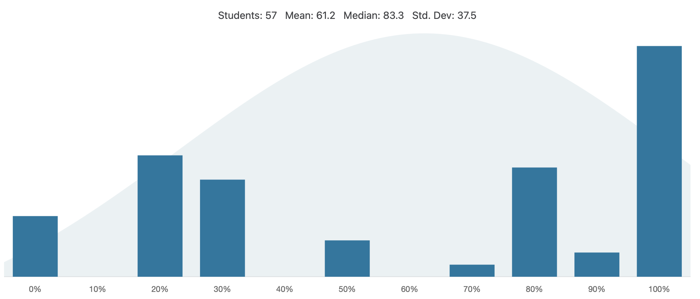
Question 5a

Slide 13
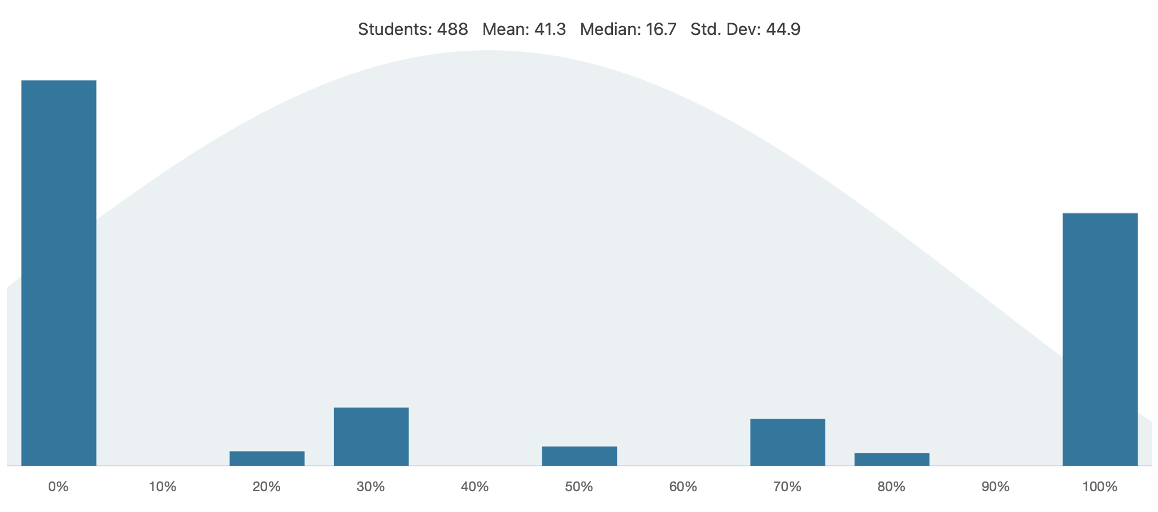
Question 5b (WINTER 2024)

Slide 14
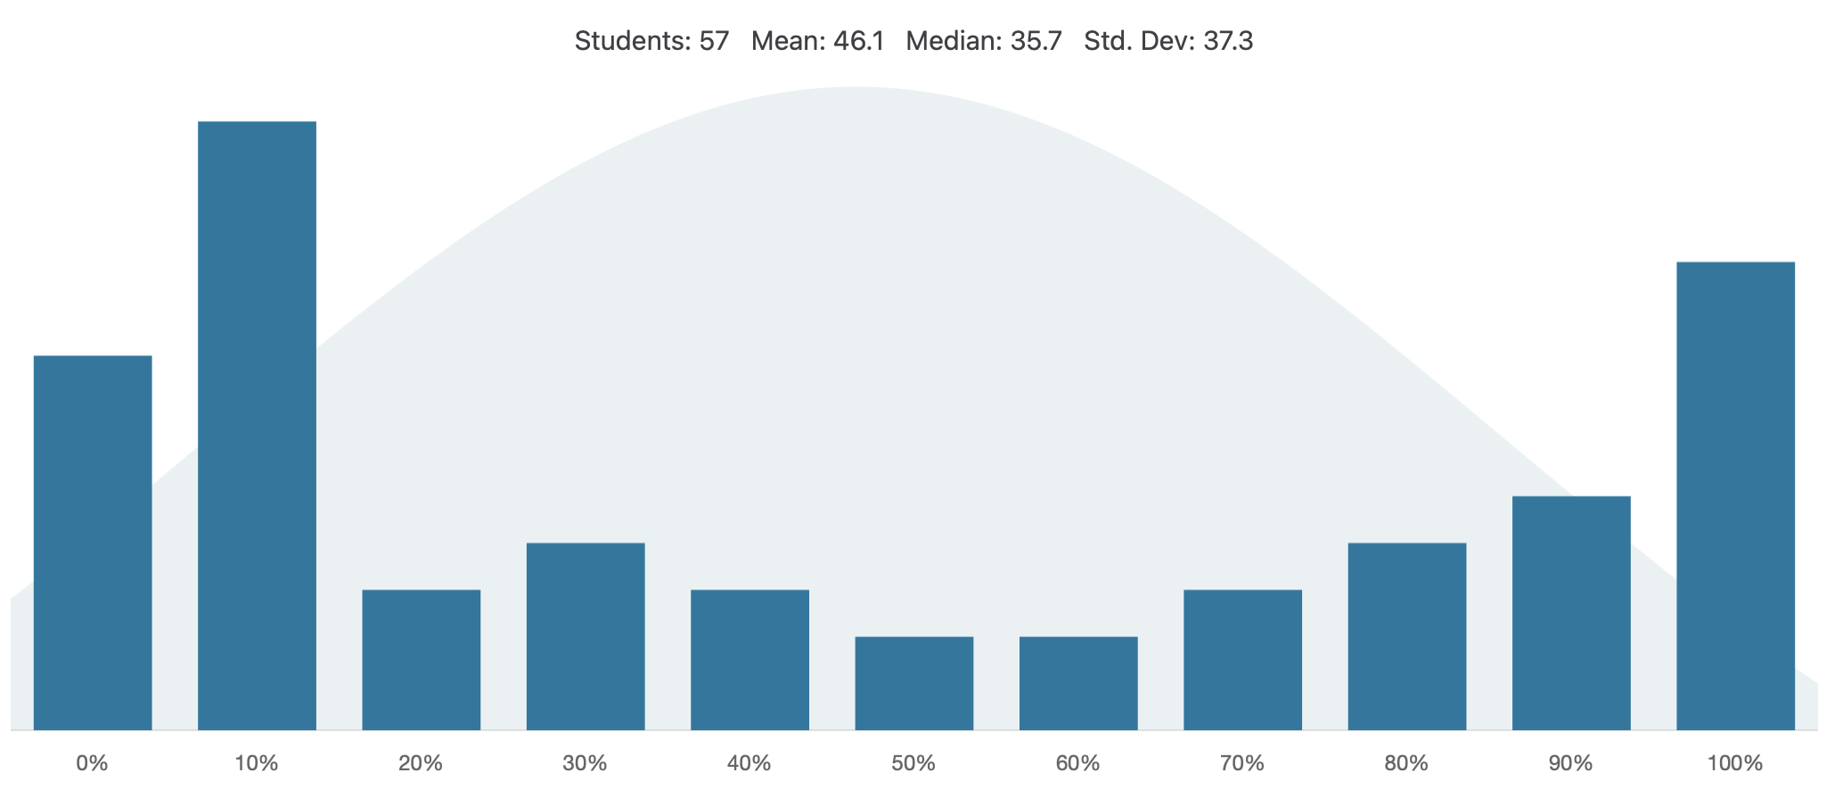
Question 5b

Slide 15

The good news about failure is it’s temporary. The bad news about success is it’s temporary.
Failure is part of the process of success. People who avoid failure also avoid success.

Slide 16
Common Mistakes
Return is not print
While loops != for loops
For loops use an iterable
While loops use a Boolean condition or expression
Can NOT do for i < 5:
Unintentional return statement inside loops
while i < 0 :
string += something
i += 1
return x

Slide 17
Common Mistakes
Strange syntax - trust your gut
NO ‘.’[i:i+1]
Know your variable types and know what you are iterating over!
my_string vs my_string[0] are very different
for i in subject:
if subject[i] == subject[i + 1]

Slide 18

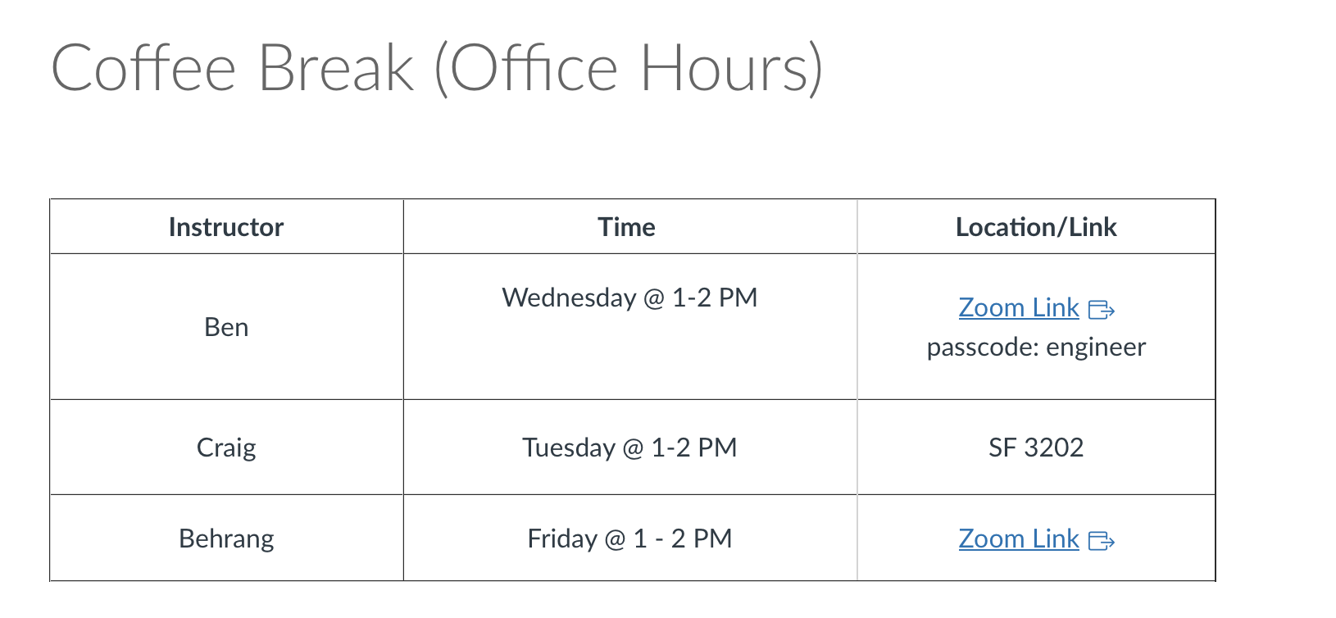

Coffee Break with Ben/Craig/Behrang!
Extra help hours!
TIP FOR SUCCESS: Put in calendar, treat as a scheduled class
Schedule and Link is on Quercus
Office Hours
Coffee Break

Slide 19
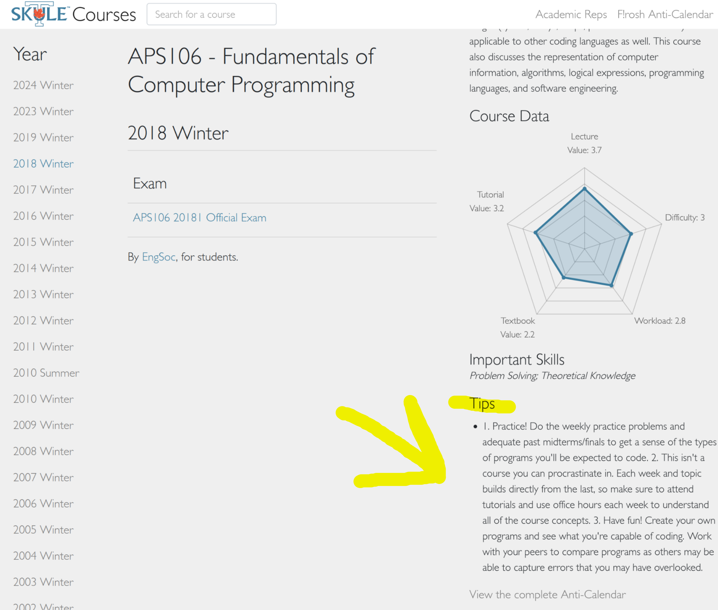
Trust peers who have been through it before!

Slide 20


Exam: June 25 at 2:00 PM (14:00), EX 200
TLDL: Be like Gandalf, not Austin Powers

Slide 21
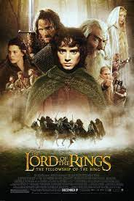
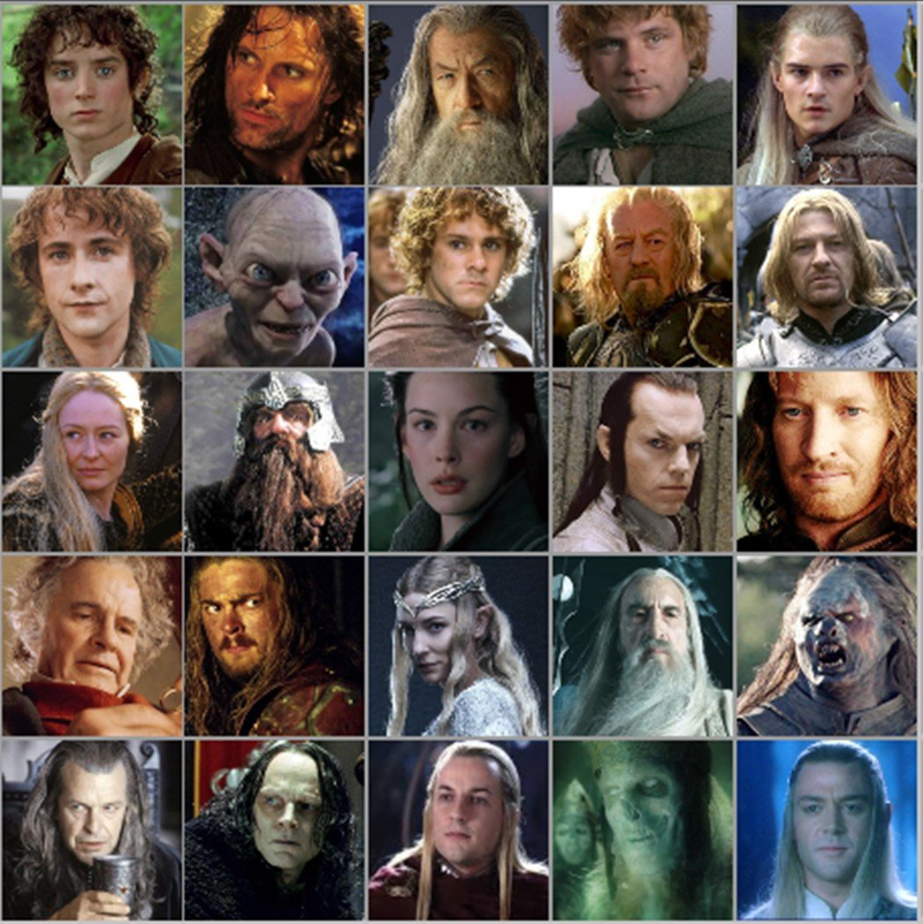


Motivation
We want to keep track of characters in a complex show/book
Name
Actor
Personality
Age
Title/Powers
We could store values in a string?
We could have unique variable names for each person?
gandalf_age = 24000
frodo = ”Frodo-Elijah Wood-brave, observant, and unfailingly polite-51-Ring bearer"
We need an efficient way to do this.

Slide 22
Motivation
We could store values in a string or other individual variables?
gandalf_name = ”Gandalf the Grey”
gandalf_age = 24000
#all other values for Gandalf in separate variables
We could have unique variable names for each person, including name, actor, personality, age and power?
frodo = ”Frodo-Elijah Wood-brave, observant, and unfailingly polite-51-Ring bearer”
#we could use frodo.split(‘-’) or frodo.find(‘-’) to split at or find the dashes
We need a more efficient way to do this

Slide 23
One way: Tables or Lists!
Name | Gender | Actor | Personality | Age | Powers
Sam | M
Frodo | M
Gandalf | M
Galadriel | F
Pippin | M
Aragorn | M
Legolas | M
Eowyn | F
Gollum | M
Arwen | F
Merry | M
Need to:
Create rows of data
Create columns of data
Be able to access a specific cell/index

Slide 24

Data Structures!
Data structures are “containers” that organize and group data
Lists
Sets
Tuples
Dictionaries
Custom classes/objects
Linked lists
Binary trees
Stacks
Queues
Arrays
Heaps

Slide 25

Type: List
Can store an ordered collection of data using Python’s type list
The general form of a list is:
Values are enclosed in ([ ]) and separated by commas (,)
Can assign lists to a variable name:
[val1, val2, val3, …, valN]
my_list = [val1, val2, val3, …, valN]

Slide 26
List Elements
list elements can be of any type:
A list can contain elements of more than one type:
subjects = [‘bio’, ‘programming’, ‘math’, ‘history’]
grades = [75, 98, 82, 62]
street_address = [10, ‘Main Street’]
light = [‘status’, True, ‘intensity’, 3.1]

Slide 27
List Operations (Indexing and Slicing)
A list can be indexed just like a string:
A list can be sliced just like a string:
>>> grades = [80, 90, 70, 45, 98, 57]
>>> grades[1]
90
>>> grades[-3]
45
>>> grades[0:2] [80, 90]
>>> grades[::-2] [57, 45, 90]

Slide 28
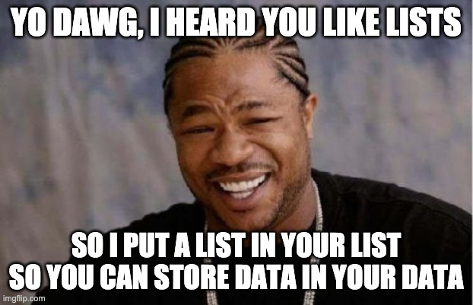
Nested Lists
Lists can contain any type, including other lists!
Called “nested lists”
To access a nested item, first select the sublist, then treat as a regular list
[list1, list2, …, listN]
[val1, val2, …, valN]
>>> list_of_lists[0]
[val1, val2, …, valN]
>>> list_of_lists[0][1]
val2

Slide 29
Nested Lists Example
Let’s provide some information in our list of grades:
Now we can access different parts depending on what we want:
>>> aps106_grades = [[‘Midterm 1’, 60],[‘Midterm 2’, 90],[‘Exam’, 100]]
>>> aps106_grades = [[‘Midterm 1’, 60],
[‘Midterm 2’, 90],
[‘Exam’, 100]]
BOTH OF THESE ARE THE SAME THING!
>>> aps106_grades[0]
[‘Midterm 1’, 60]
>>> aps106_grades[2][1]
100

Slide 30
Let’s Code!
Let’s take a look at how this works in Python!
Creating lists
List indexing and slicing
List operations
Nested lists!
Open your notebook
Click Link:
1. The ‘list’ Type

Slide 31
List Mutability
Lists are mutable!
This means they can be mutated (modified)
All the other types we’ve learned so far (string, int, float, and bool) are immutable (i.e. they can NOT be modified)

Slide 32
List Mutability Example
>>> s = “I love cats”
s[0] = “U”
Traceback (most recent call last):
builtins.TypeError: 'str' object does not support item assignment
>>> grades = [80, 90, 70, 45, 98, 57]
>>> grades[3] = 100
>>> grades[-1] = 100
>>> grades[2] = ‘Perfect’
>>> grades
[80, 90, ‘Perfect’, 100, 98, 100]
strings are immutable
lists are mutable

Slide 33
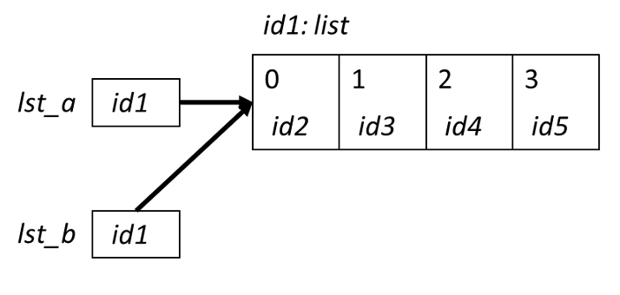

Aliasing
When two variable names refer to the same object, they are aliases.
When we modify one variable, we are modifying the object it refers to, hence also modifying the second variable.
This is common source of error when working with list objects.

Slide 34
Aliasing Example (with Visualizer)
Permalink:
https://tinyurl.com/aps106alias

Slide 35
Avoiding Aliasing
>>> lst1 = [11, 12, 13, 14, 15, 16, 27]
>>> lst2 = lst1
>>> lst1[-1] = 17
>>> lst2
[11, 12, 13, 14, 15, 16, 17]
>>> id(lst1)
49012568
>>> id(lst2)
49012568
How can we copy lst1 into another list without aliasing?

Slide 36
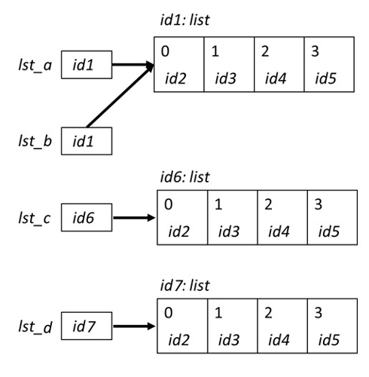
Copying Lists and Avoiding Aliasing
There are two simple ways to copy lists:
Using the list( ) function
Completely slice the list [:]
>>> lst_a = [0, 1, 2, 3]
>>> lst_b = lst_a
>>> lst_c = list(lst_a)
>>> lst_d = lst_a[:]
>>> id(lst_a)
39012510
>>> id(lst_b)
39012510
>>> id(lst_c)
54514112
>>> id(lst_d)
24514139

Slide 37
Avoiding Aliasing Example (with Visualizer)
Permalink:
https://tinyurl.com/aps106alias2

Slide 38
Let’s Code!
Let’s take a look at how this works in Python!
List mutability
Aliasing
Copying lists
Open your notebook
Click Link:
2. Mutability and Aliasing

Slide 39
Built-in Functions
Several of Python's built-in functions can be applied to lists, including:
len(list) : return the number of elements in list (i.e. the length)
min(list) : return the value of the smallest element in list.
max(list) : return the value of the largest element in list.
sum(list) : return the sum of elements of list (list items must be numeric).

Slide 40
List Methods
Lists are objects and just like other objects, the list type has associated methods that are only valid for lists
Recall you can find out which methods are associated with objects using the built-in function dir
>>> dir(list)
['__add__', '__class__', '__class_getitem__', '__contains__', '__delattr__', '__delitem__', '__dir__', '__doc__', '__eq__', '__format__', '__ge__', '__getattribute__', '__getitem__', '__gt__', '__hash__', '__iadd__', '__imul__', '__init__', '__init_subclass__', '__iter__', '__le__', '__len__', '__lt__', '__mul__', '__ne__', '__new__', '__reduce__', '__reduce_ex__', '__repr__', '__reversed__', '__rmul__', '__setattr__', '__setitem__', '__sizeof__', '__str__', '__subclasshook__', 'append', 'clear', 'copy', 'count', 'extend', 'index', 'insert', 'pop', 'remove', 'reverse', 'sort']

Slide 41
Adding Items to a List
To add an object to the end of a list, use the list method append:
To add a list to the end of a list, use the list method extend:
>>> colours = ['blue', 'yellow’] >>> colours.append('brown’) >>> colours ['blue', 'yellow', 'brown']
>>> colours = ['blue', 'yellow’] >>> colours.extend([‘pink’,‘green’]) >>> colours ['blue', 'yellow', ‘pink’, ‘green’]

Slide 42
Removing Items from a List
To remove an object from a list, use the list method remove:
How can we write it so there’s no error?
>>> colours = ['blue', 'yellow’, ‘pink’] >>> colours.remove(‘yellow’) >>> colours ['blue', ‘pink’]
>>> colours.remove(‘red’)
Traceback (most recent call last):
builtins.ValueError: list.remove(x): x not in list

Slide 43
Is something in my list?
The in operator can be used on lists too!
colours = ['blue', 'yellow’, ‘pink’]
if ‘red’ in colours:
colours.remove(‘red’)

Slide 44
Let’s Code!
Let’s take a look at how this works in Python!
Open your notebook
Click Link:
3. List Methods

Slide 45

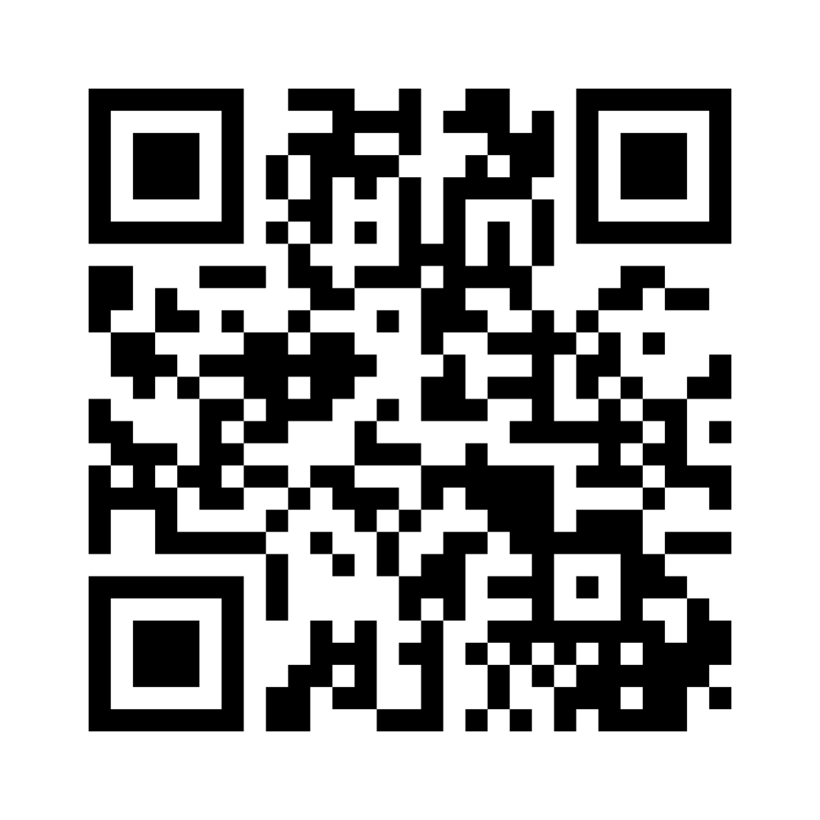
Mentimeter Checkpoint
Join at www.menti.com:
Code: 9952 2951
Link
https://www.menti.com/bl6ghq8f59mk

Slide 46
Lists: indexing and slicing.
Week 5 | Lecture 1 (5.1.1)

